Slide 1
Welcome, it’s SQL Practice time!

Slide 2
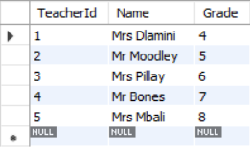
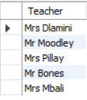
Recap on Aliases
SELECT * FROM Teachers;
SELECT Name AS Teacher FROM Teachers;

Slide 3
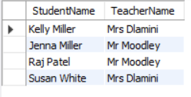
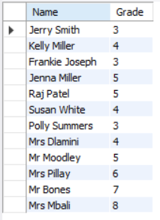
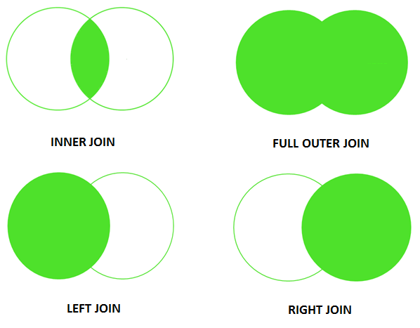
Recap on Joins
Notes:
Inner join: Only brings back data where the grade of a student matches the grade the teacher teaches since the inner join happens on the grade column available in the Students and Teachers table.
Full outer join: Brings back all students and teachers with their respective grades.

Slide 4
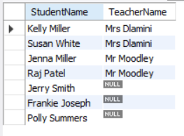
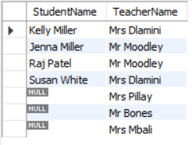
Recap on Joins
Notes:
Left join: Will return all the students with their teacher, if a student does not have a teacher it returns ‘NULL’.
Right join: Will return all the teachers with their students, if a teacher does not have a student it returns ‘NULL’.

Slide 5
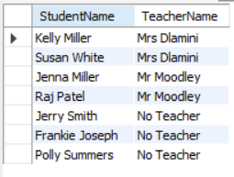
Recap on Null Functions
SELECT StudentName, IFNULL(Name, 'No Teacher') AS TeacherName
FROM ltc.Students
LEFT JOIN ltc.Teachers
ON ltc.students.Grade = ltc.Teachers.Grade

Slide 6
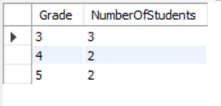
Recap on Group by
SELECT Grade, Count(*) AS NumberOfStudents
FROM ltc.Students
GROUP BY Grade
Notes:
When you use an aggregate function like count() you can use group by to sum by grade.

Slide 7


Your task
Design a database for
is obviously an ecommerce company, essentially, they sell things online.

Slide 8
Ready?....Go!
Database requirements:
Must be able to capture customer details. This includes name, surname, email and contact details.
Must be able to capture delivery address. Each customer can have many delivery addresses.
Must be able to capture product details. This includes the product name, description and price.
Must be able to capture customer orders. Each customer can have many orders, and each order can have multiple products. Capture the date the order was delivered and whether the order was paid for.
Notes:
Note to self, talk over BLOBs or absolute path for images for the Product table.

Slide 9
Ready?....Go!
Insert some data:
Add yourself as a customer.
Add your delivery address, ensure it is linked to your customer record.
Add 2 different products of your choice.
Add a single order containing the 2 products you created above and make sure it is linked to your customer record.

Slide 10
Possible solution for Fakealot
Get the practiceTime.sql script under the SQL section from https://github.com/almarieSaayman/ladiesThatCode

Slide 11
Activity 1
Select the most expensive product from Fakealot.

Slide 12


Activity 1 – Possible solution

Slide 13
Activity 2
Select all the products whose price is between 200 and 400.

Slide 14
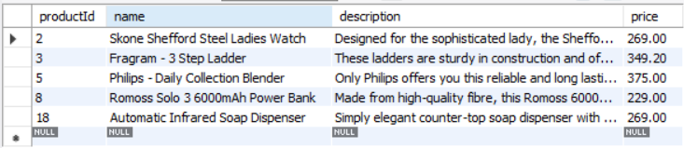

Activity 2 – Possible solution

Slide 15
Activity 3
Select all the customers whose surname contains ‘an’.

Slide 16
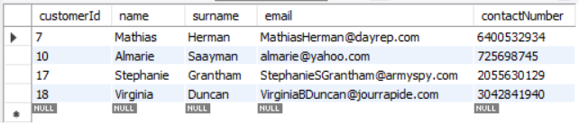

Activity 3 – Possible solution

Slide 17
Activity 4
Select all the orders that have not been paid for. You must use the NOT keyword.

Slide 18


Activity 4 – Possible solution

Slide 19
Activity 5
Get the total amount for all orders that have not been paid for. You do not need to use the NOT keyword.

Slide 20

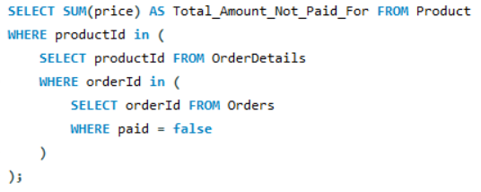
Activity 5 – Possible solution

Slide 21
Activity 6
Select all the customers that live in Sweden or Brazil.

Slide 22
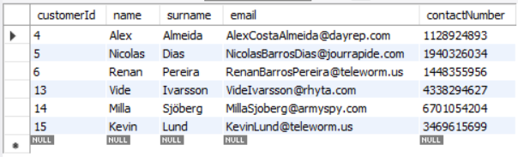
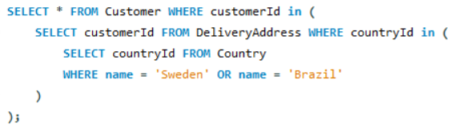
Activity 6 – Possible solution

Slide 23
Activity 7
Update the postal code to 8000 for the customer with the name ‘Doreen’.

Slide 24

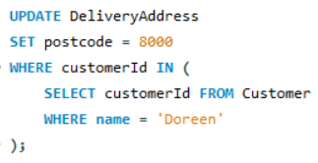
Activity 7 – Possible solution

Slide 25
Bonus Activity
Get the total amount spend and customer name and surname for the customer that spend the most money at Fakealot.

Slide 26

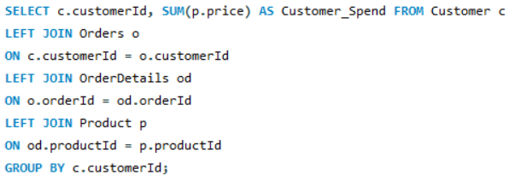
Bonus Activity – Possible solution

Slide 27
Questions?

